Slide 1
Lecture 17: Recursion
CSC111: Introduction to CS through Programming
R. Jordan Crouser
Assistant Professor of Computer Science
Smith College

Slide 2
Outline
Motivating example: Towers of Hanoi
Tough problems, simple solutions
More Recursion & Recursive Functions
Finding the Largest in a List
Finding the Smallest in a List
Traversing a Maze
Fractal Trees
Lab

Slide 3
Towers of Hanoi

Slide 4
Rules of the game
You can only move one disk at a time
You can only move a disk to a pole where it will be the smallest (i.e. you can’t put a disk on top of a larger one)
You can only remove the smallest disk from a pole (i.e. you can’t lift up the stack to get a larger disk from below)

Slide 5

Discussion
Notice any patterns?

Slide 6
Recursive Towers
solve this
subproblem

Slide 7
Recursive Towers

Slide 8
Recursive Towers
move this
disk

Slide 9
Recursive Towers

Slide 10
Recursive Towers
solve this
subproblem

Slide 11
Recursive Towers

Slide 12
Recursive Towers
solve this
subproblem

Slide 13
Recursive Towers
solve this
subproblem

Slide 14
Recursive Towers

Slide 15
Recursive Towers
move this
disk

Slide 16
Recursive Towers

Slide 17
Recursive Towers
solve this
subproblem

Slide 18
Recursive Towers
…and so on!

Slide 19
The legend
Notes:
The puzzle was invented by the French mathematician Édouard Lucas in
1883.
There is a story about an Indian temple in Kashi Vishwanath which contains a
large room with three time-worn posts in it surrounded by 64 golden disks.
Brahmin priests, acting out the command of an ancient prophecy, have been
moving these disks, in accordance with the immutable rules of the Brahma,
since that time. The puzzle is therefore also known as the Tower of Brahma
puzzle. According to the legend, when the last move of the puzzle will be
completed, the world will end.

Slide 20
Discussion
How many moves does it take?

Slide 21
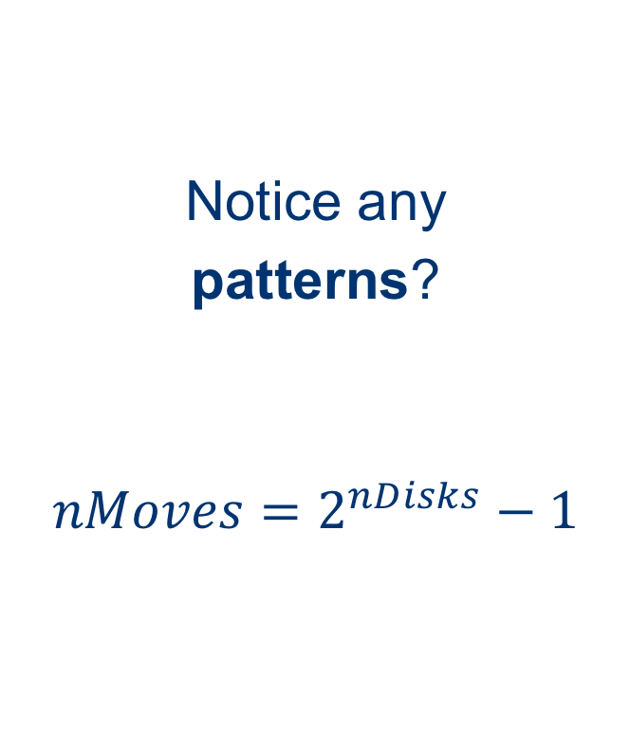
Algorithmic analysis
nDisks | nMoves
1 | 1
2 | 3
3 | 7
4 | 15
5 | 31
6 | 64
7 | 127
Notice any
patterns?
$$nMoves=2^{nDisks}−1$$

Slide 22
So… when will the world end?
Notes:
Roughly 584 BILLION years after they started

Slide 23
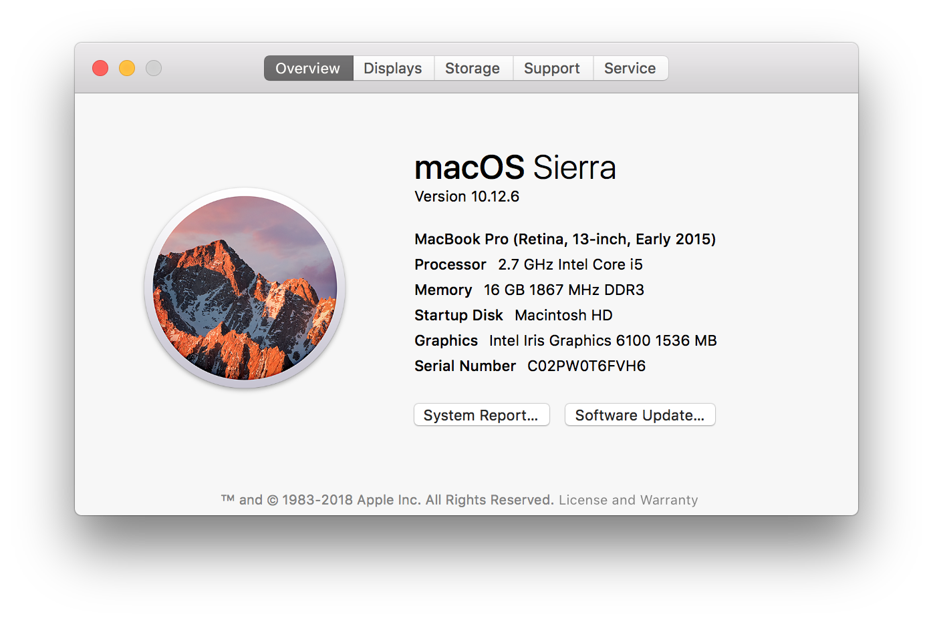
How about using a laptop?
Notes:
2.7 GHz processor means my laptop can perform roughly 2.7 billion operations per second
Let’s be generous and assume that we can move a disk in a single operation (we can’t)
2^64ops / 2.7 billion ops per second / 84000 seconds per day / 365 days per year = 46,154.4 years
So we’ve got some time ☺

Slide 24
Basic structure of a recursive algorithm
A base case: what to do in the simplest possible case (i.e. when you have a single disk)
A recursive step: break the original problem into one or more smaller problems, and solve that (saving the intermediate result)

Slide 25
Demo: Towers of Hanoi in Python
Notes:
(live implementation of code on slide 27) – this is usually where I’d end if I were breaking this into two lectures

Slide 26
Recursion themes
“Looping without a loop”
“A function that calls itself as part of its definition”
“Solving a problem by solving smaller instances”
Key components of all three:
a recursive step (i.e. knowing when to split)
a “base case” (i.e. knowing when to stop)

Slide 27
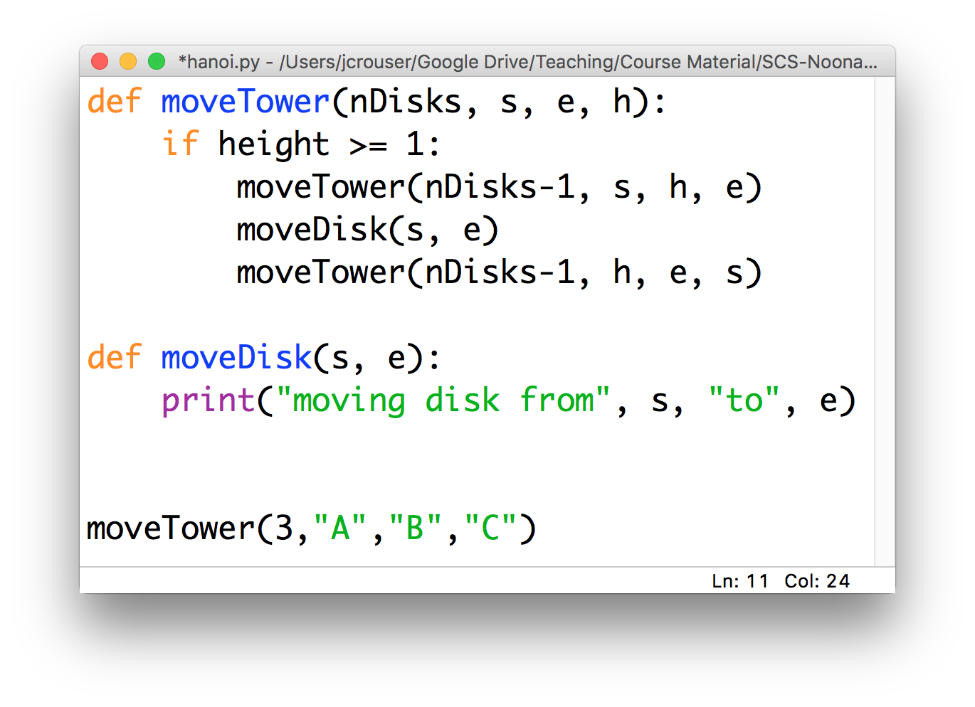
Recap: recursive functions (Hanoi)

Slide 28
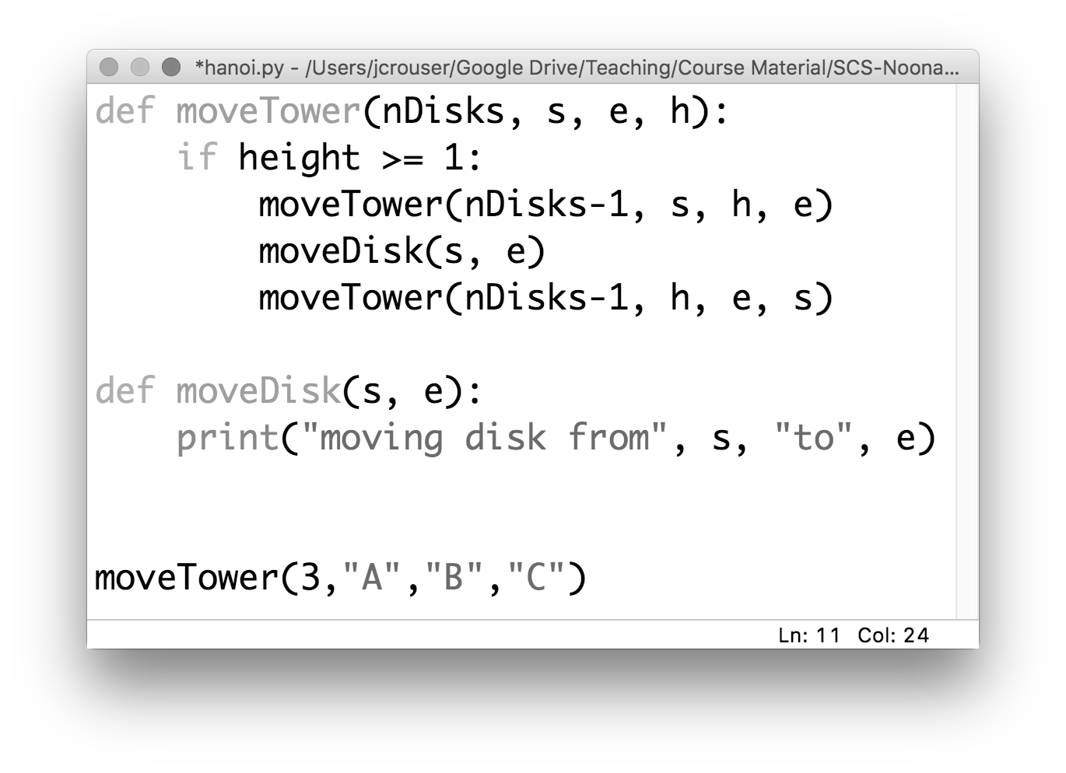
Recap: recursive functions (Hanoi)

Slide 29
Discussion
What actually happens in memory
when you call a function?

Slide 30
the “stack”
the program
in memory
def f1(a):
y = f2(a+1)
return y
def f2(b):
z = b
if (z > 2):
z = z/2
return b^2
f1(3)

Slide 31
the “stack”
the program
in memory
def f1(a):
y = f2(a+1)
return y
def f2(b):
z = b
if (z > 2):
z = z/2
return b^2
f1(3)

Slide 32
the “stack”
the program
in memory
def f1(a):
y = f2(a+1)
return y
def f2(b):
z = b
if (z > 2):
z = z/2
return b^2
f1(3)
f1(3): y

Slide 33
the “stack”
the program
in memory
def f1(a):
y = f2(a+1)
return y
def f2(b):
z = b
if (z > 2):
z = z/2
return b^2
f1(3)
f1(3): y

Slide 34
the “stack”
the program
in memory
def f1(a):
y = f2(a+1)
return y
def f2(b):
z = b
if (z > 2):
z = z/2
return b^2
f1(3)
f2(4): z
f1(3): y

Slide 35
the “stack”
the program
in memory
def f1(a):
y = f2(a+1)
return y
def f2(b):
z = b
if (z > 2):
z = z/2
return b^2
f1(3)
f1(3): y

Slide 36
the “stack”
the program
in memory
def f1(a):
y = f2(a+1)
return y
def f2(b):
z = b
if (z > 2):
z = z/2
return b^2
f1(3)
…whatever’s next!

Slide 37
Discussion
What actually happens in memory
when you call a function
recursively?

Slide 38
the “stack”
the program
in memory
…
def f3(a):
if (a == 1):
return 1
else:
x = f3(a-1)+1
f3(100)
f3(97): x
f3(98): x
f3(99): x
f3(100): x
…but isn’t there limited space?

Slide 39
Demo: recursive addition

Slide 40
Trivia
Ever wonder where the name
came from?

Slide 41
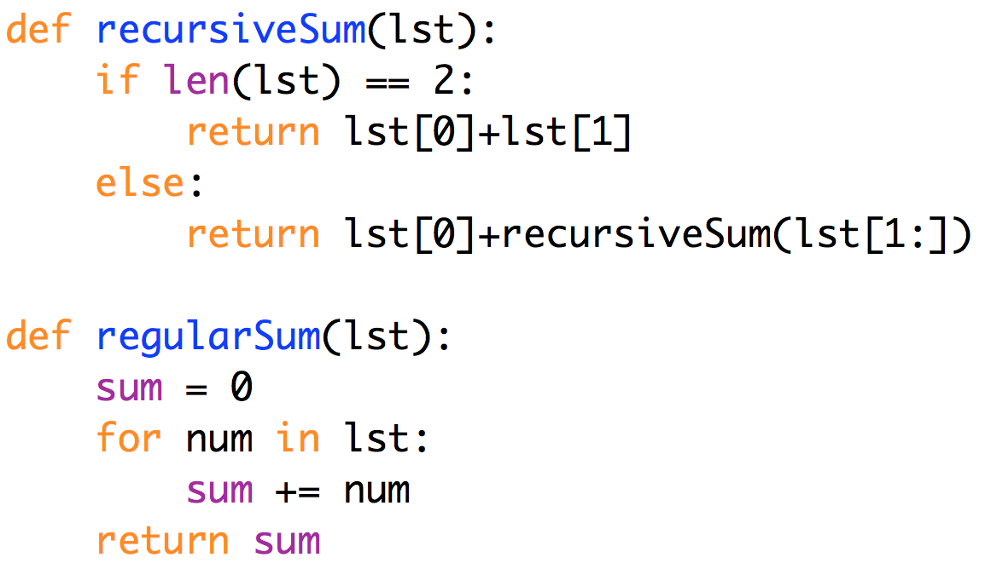
Recursive vs. iterative addition
in this case,
the iterative solution
feels cleaner
Notes:
Anything you can write recursively, you can also write iteratively. This avoids the issue of having to duplicate all the local variables, etc. and so poof! No more recursion depth issues.
Moreover, some problems just seem to make more sense as a loop.

Slide 42
Discussion
How would you solve Tower of Hanoi iteratively?
Notes:
It’s always the case that you CAN rewrite recursive code as iterative code. But it isn’t always pretty.
It’s really hard to describe, right?

Slide 43
More problems with recursive solutions
15 minute (non-programming) Challenge:
How would you program a robot to solve a maze?

Slide 44
A recursive solution
Mark your current location as visited
If you’re at the end, you’re done!
If not:
If unmarked, go NORTH, solve maze. If not solved, go back and:
If unmarked, go SOUTH, solve maze. If not solved, go back and:
If unmarked, go EAST, solve maze. If not solved, go back and:
If unmarked, go WEST, solve maze. If not solved, NO SOLUTION

Slide 45
Clever recursion allows backtracking!
Mark your current location as visited
If you’re at the end, you’re done!
If not:
If unmarked, go NORTH, solve maze. If not solved, go back and:
If unmarked, go SOUTH, solve maze. If not solved, go back and:
If unmarked, go EAST, solve maze. If not solved, go back and:
If unmarked, go WEST, solve maze. If not solved, NO SOLUTION

Slide 46
Discussion
What is the
most confusing thing
about recursion?

